Slide 1
Edge service discovery
Jun cao、Jane、Xuebai

Slide 2
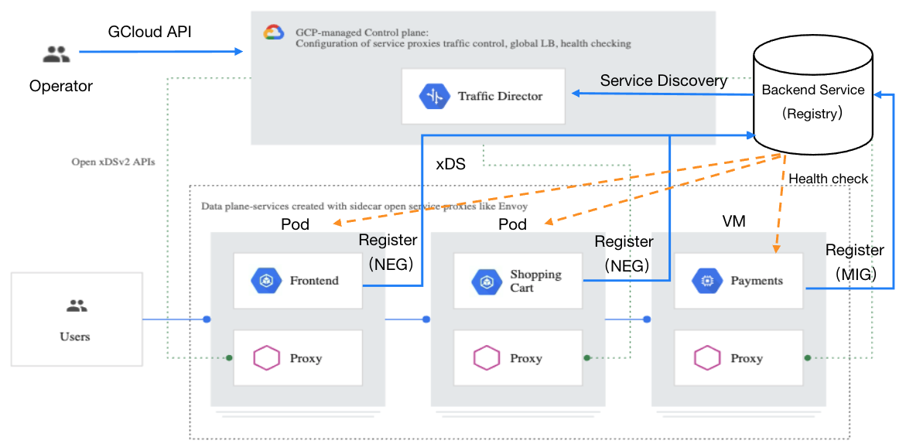
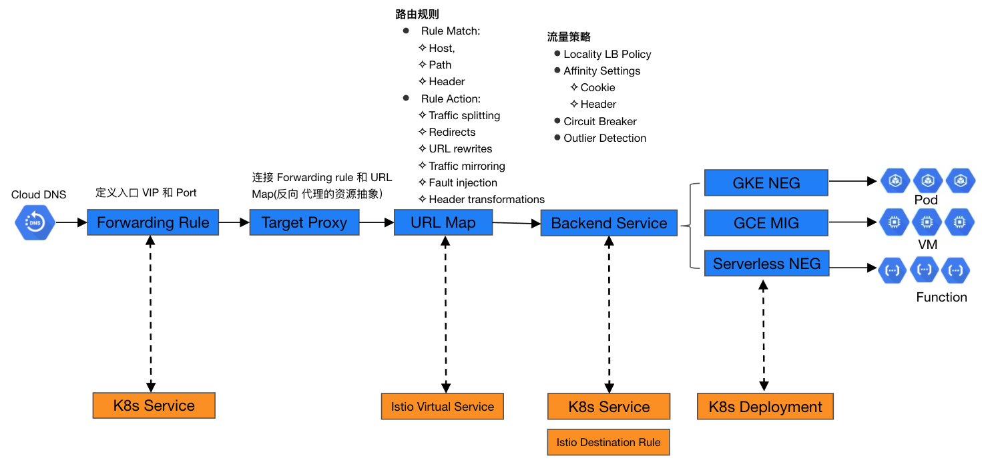
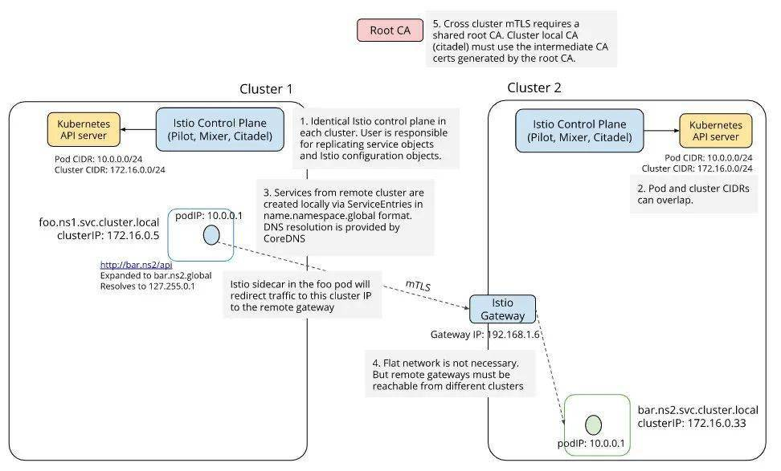
Edge service discovery
According to the app distribution, UE client location, APP QoS requirements and other conditions, the edge sites are allocated
Public Cloud
Node selector
（Policy)
Service Registor
Application/Service
Similar to CoreDNS?
Coredns is a static configuration, but edge service discovery is a dynamic allocation process
Coredns does not have the concept of cluster and edgesite and the allocation process
Cluster
Edge Site
Google Traffic director
UE
MEC
UE Client
Gateway/
Outbound Service
Router/
Traffic Polucy
Backend Service
Backend Instacne
Access edge service
Similar to istio, rules mapped to envoy are supported
ISTIO: Multi-cluster service discovery
Notes:
https://www.servicemesher.com/blog/20200818-google-cloud-mesh/

Slide 3
First discovery
First discovery: UE finds and connects to the service discovery component
Suggested mode 1: UE directly finds the IP of the core through DNS and connects to the core
Public Cloud
Core service discovery
Global Manager
API Layer
DNS Server
(Local DNS - Authoritative DNS)
Node Selector
Service Register
Common
File
Config
Agent
Cluster
Cluster
Plugin 1
Plugin 1
Log
...
...
Edge Site
Edge Site
Edge Site
Edge Site
Plugin N
DB
Region (Public Cloud)
Plugin N
Health
Pod
Mode 1. Get the IP of the core through DNS and connect to the core
Local
service discovery
Gateway
VM
MEC
UPF
Local service discovery
MEP/EdgeCore
API Layer
Edge (Public Cloud
Traffic Handler
Service Register
Common
Plugin 1
Plugin 1
File
Config
Agent
Pod
...
...
Log
Gateway
Plugin N
DB
Pod
Local
service discovery
Plugin N
Health
VM
no core, only local
Mode 2. Connect to local first through 5g network capabilities such as UPF
Gateway
VM
MEC
UE
Local service discovery
Mode 3. Configure local address directly in UE
Pod
Client APP
Gateway
VM
SDK/
Envoy-mobile
Mode 2：UPF intercepts all requests, identifies DNS protocol, and forwards them to local <Only DNS protocol is supported>
Notes:
跨集群/跨云：
1. 由一个管理组件管理服务列表，同步到各个集群/云，各个集群/云有相同的副本
2. 分布式，集群/云间转发查询请求，各个集群/云只有自己的服务列表、其它集群/云列表、转发策略

Slide 4
Node Selection/Service allocation(static assignment)
Service assignment：According to the location of the UE and the QoS requirements of the application, service discovery allocates the edge and service instance to the UE, and returns the access address of the service instance at the edge site
Static assignment：The deployment of service instances has been completed on the edge and cloud, and only assignment through policies and algorithms
Interaction protocol：Special service discovery API is used between UE and service discovery
Suggested mode 1:UE is directly connected to the core, and node selection / service allocation is performed by the core
Public Cloud
Core service discovery
Deploy the application instance at the edge site and register to service discovery
Global Manager
API Layer
Node Selector
Service Register
Common
Config
Agent
Plugin 1
Plugin 1
File
Cluster
Cluster
...
...
Log
Edge Site
Edge Site
Edge Site
Edge Site
Plugin N
DB
Region(Public Cloud)
Plugin N
Health
Pod
Mode 1. The core allocates services and returns the access address of the service instance
Local
service discovery
Gateway
VM
MEC
Local service discovery
MEP/EdgeCore
API Layer
Edge(Public Cloud)
Traffic Handler
Service Register
Common
Plugin 1
Plugin 1
File
Config
Agent
Pod
...
...
Log
Gateway
Plugin N
DB
Pod
Local
service discovery
Plugin N
Health
VM
Mode 2. The core selects an edge for the UE and returns the local address. The UE connects to the local and the local allocates services
Gateway
VM
UE
Client APP
SDK/
Envoy-mobile
Notes:
跨集群/跨云：
1. 由一个管理组件管理服务列表，同步到各个集群/云，各个集群/云有相同的副本
2. 分布式，集群/云间转发查询请求，各个集群/云只有自己的服务列表、其它集群/云列表、转发策略

Slide 5
Node Selection/Service allocation(dynamic deployment)
Service assignment：According to the location of the UE and the QoS requirements of the application, service discovery allocates the edge and service instance to the UE, and returns the access address of the service instance at the edge site
Dynamic deployment：If there is no service instance on the appropriate edge, the dynamic deployment of service instance is triggered. The service instance deployment is triggered by the access traffic to realize the serverless mode
Public Cloud
Core service discovery
There is no service instance deployed at the nearest edge, which triggers the dynamic deployment of service instance
API Layer
Global Manager
Node Selector
Service Register
APP Adjustor
Common
Config
Agent
Plugin 1
Plugin 1
Plugin 1
File
Cluster
Cluster
...
...
...
Log
Edge Site
Edge Site
Edge Site
Edge Site
Plugin N
Plugin N
DB
Region(Public Cloud)
Plugin N
Health
Pod
Request the core for service allocation and return the access address of the service instance
Local
service discovery
Gateway
VM
MEC
Local service discovery
MEP/EdgeCore
Deploying services at edge sites
API Layer
Edge(Public Cloud)
Traffic Handler
Service Register
Common
Plugin 1
Plugin 1
File
Config
Agent
Pod
...
...
Log
Gateway
Plugin N
DB
Pod
Local
service discovery
Plugin N
Health
VM
Gateway
VM
UE
UE Client
SDK/
Envoy-mobile
Notes:
跨集群/跨云：
1. 由一个管理组件管理服务列表，同步到各个集群/云，各个集群/云有相同的副本
2. 分布式，集群/云间转发查询请求，各个集群/云只有自己的服务列表、其它集群/云列表、转发策略

Slide 6
Multi-Operator
Public Cloud 1(China Unicom)
Public Cloud 2(China Mobile)
Public Cloud 1(China Unicom)
Public Cloud 2(South Korea SKT)
Core
service discovery
Global Manager
Global Manager
Core
service discovery
Global Manager
Core
service discovery
Global Manager
Config
Agent
Config
Agent
Config
Agent
Cluster
Cluster
Config
Agent
Cluster
Cluster
Edge Site
Edge Site
Edge Site
Edge Site
Edge Site
Edge Site
DNS Server
(Local DNS - Authoritative DNS)
Edge Site
Edge Site
MEC(Cloud 1)
Mode 1：There is only one core, and other cloud services are imported into the core
For example, there is only one core in China
MEC(Cloud 1)
Mode 2：There are multiple cores, and they cooperate with each other
For example, China has a core, and so does South Korea
Local service discovery
MEP/EdgeCore
Local service discovery
MEP/EdgeCore
Config
Agent
Config
Agent
Pod
Pod
Gateway
VM
Gateway
VM
MEC(Cloud 2)
MEC(Cloud 2)
Local service discovery
Local service discovery
GuangDong-GuangZhou
Pod
Pod
UE
BGP
Gateway
VM
UE
UE
Gateway
VM
UE Client
UE Client
UE Client
GuangDong-ShenZhen
move，switch network
ShenZhen
UE may switch network (e.g. virtual SIM card supports multiple operators)

Slide 7
Multi-Cloud/Multi-Operator
Public Cloud 1(Huawei Cloud)
Public Cloud 2(Alicloud)
Public Cloud 1(Huawei Cloud)
Public Cloud 2(China Unicom)
Core
service discovery
Global Manager
Global Manager
Core
service discovery
Global Manager
Global Manager
Config
Agent
Config
Agent
Config
Agent
Cluster
Cluster
Config
Agent
Cluster
Cluster
Edge Site
Edge Site
Edge Site
Edge Site
Edge Site
Edge Site
Edge Site
Edge Site
Edge(Cloud 1)
Cl
oud
Access
Edge(Cloud 1)
Local service discovery
MEP/EdgeCore
Local service discovery
MEP/EdgeCore
Config
Agent
Config
Agent
Pod
Pod
Gateway
VM
Gateway
VM
Edge(Cloud 2)
UPF
MEC(Cloud 2)
GuangDong-GuangZhou
Local service discovery
Local service discovery
Pod
GuangDong-GuangZhou
Pod
UE
Gateway
VM
UE
Gateway
VM
UE Client
UE Client
GuangDong-ShenZhen
GuangDong-ShenZhen
ShenZhen
ShenZhen

Slide 8
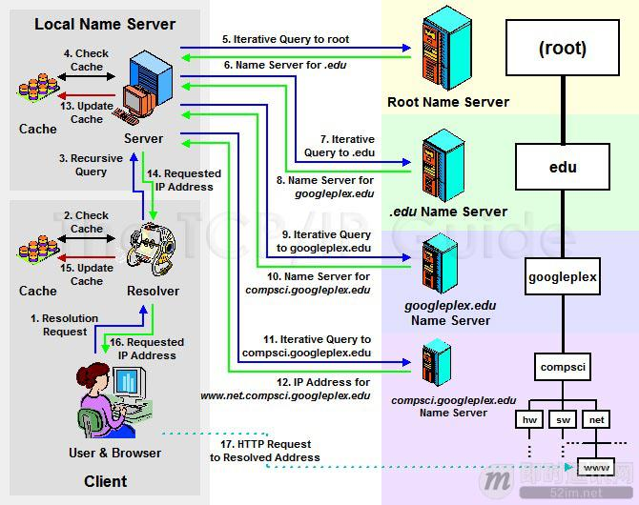
Implement
Can we use DNS server to realize service discovery between UE and edge in 5G MEC scenario?
  DNS protocol has been fixed and does not have the ability to expand. DNS request can't carry other information such as terminal ID and location. DNS response only has IP address and can't carry other information such as port number
  DNS has real-time problems, DNS has caching, effective time and other mechanisms, so it is not suitable for application dynamic deployment / adjustment scenarios
DNS is not an ideal solution for service discovery
Local DNS is provided by mobile operators
Public Cloud
Mode 1. Making decisions directly through the core
Http DNS
Layer
Global Manager
DNS
Server
Config
Agent
Cluster
Httpdns request (with location, terminal IP and other information)
Edge Site
Edge Site
Httpdns establishes a new set of interactive protocols
EDNS0(with IP to express location information)
MEC
UPF
DNS Server
MEP/EdgeCore
Config
Agent
Pod
Mode 2. Local and core decision making (e.g. UE cannot connect to core)
UE
Gateway
VM
DNS protocol
UE Client
UPF intercepts all requests, identifies DNS protocol, and forwards them to local service discovery
Get the location information through UPF and other network capabilities

Slide 9
Simple Demo(HttpDNS+DNS)
According to the POS parameter in the request, select shenzhen.cluster.myphone.ns1.svc
Cloud
TODO：
1. Make a set of DNS rules with location (edge site), cluster and namespace
2. How to declare which edge services need to be exposed, such as expanding new objects in k8s and labeling existing istio objects
3. Develop HTTP DNS protocol interface
Http DNS
Layer
Global Manager
DNS
Server
Config
Agent
Cluster
Edge Site
Edge Site
CNAME corresponding to myphone.ns1.svc
shenzhen.cluster.myphone.ns1.svc：10.20.10.10
hangzhou.cluster.myphone.ns1.svc：10.20.60.20
temporary plan：myphone.ns1 . SVC corresponds to multiple cnames, and HTTP DNS layer selects one
http://xx.xx.xx.xx/<account-id>/d? svc=myphone.ns1.svc&pos=shenzhen&ip=xx.xx.xx.xx
MEC
<edgesite>.<cluster>.<service_name>.<namespace>.svc
UPF
DNS Server
MEP/EdgeCore
Config
Agent
myphone.ns1.svc.cluster.local: IP in Cluster
shenzhen.cluster.myphone.ns1.svc：
IP of Gateway
myphone.ns1.svc：
IP of Gateway
Service
Pod
MEC
Gateway
UPF
DNS Server
MEP/EdgeCore
10.20.10.10
Config
Agent
深圳
myphone.ns1.svc.cluster.local
hangzhou.cluster.myphone.ns1.svc
Service
Pod
UE
Gateway
myphone.defaultcluster
UE Client
10.20.60.20
HuangZhou
ShenZhen
Httpdns + DNS can work, which shows that it is feasible to combine with cloud native technology, but it is not an ideal solution

